Slide 2

Applied Algorithm Lab
Max even sub-sequence

Slide 3
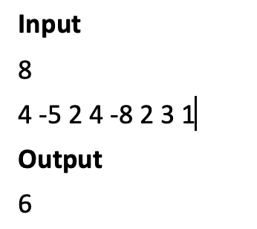
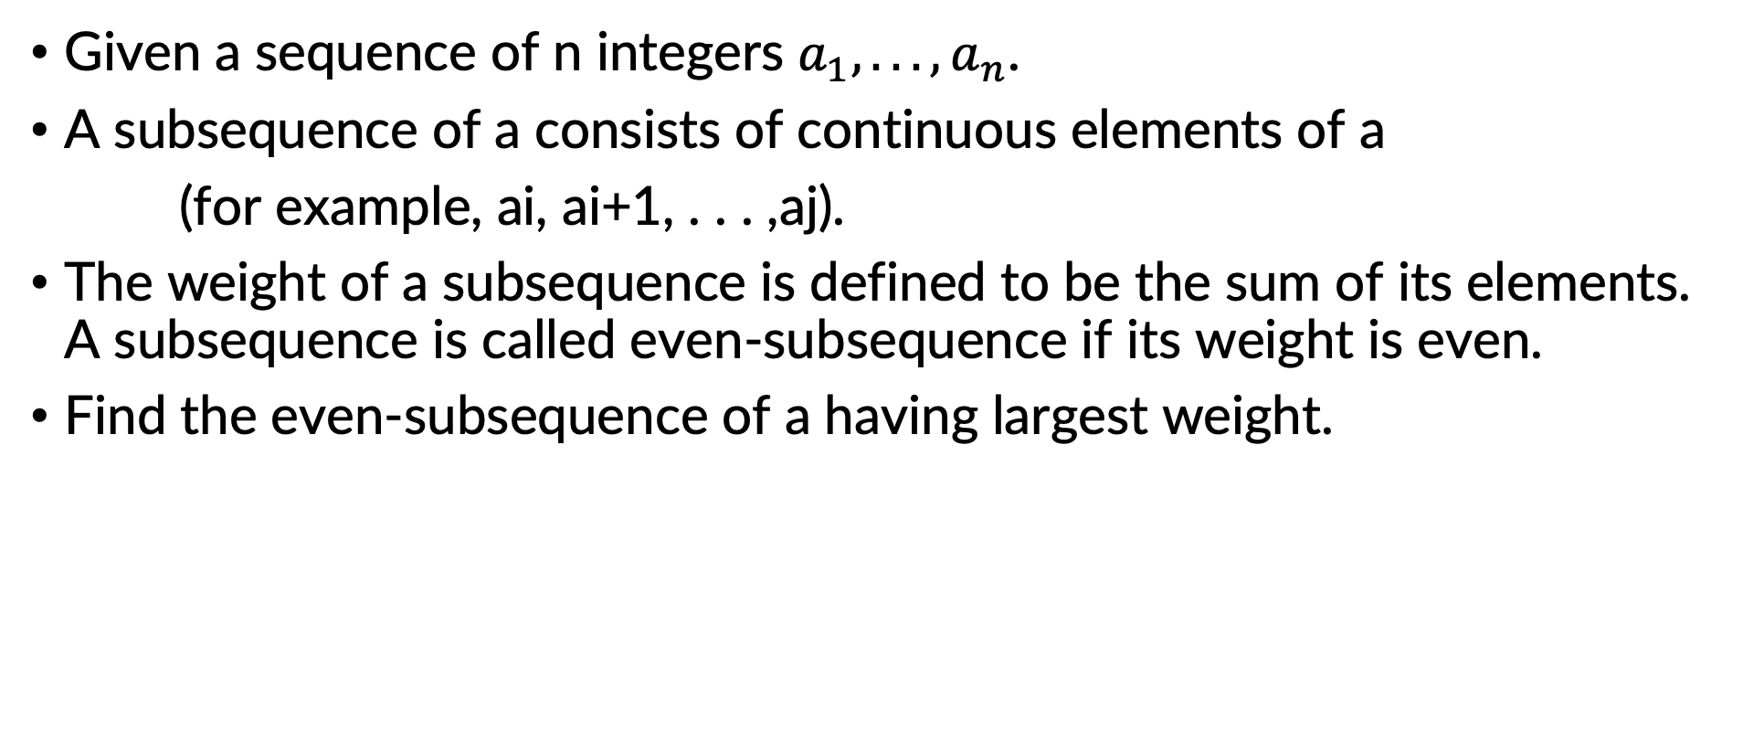
Max even sub-sequence
Given a sequence of n integers $a_{1}, . . ., a_{n}$.
A subsequence of a consists of continuous elements of a
(for example, ai, ai+1, . . . ,aj).
The weight of a subsequence is defined to be the sum of its elements. A subsequence is called even-subsequence if its weight is even.
Find the even-subsequence of a having largest weight.

Slide 4
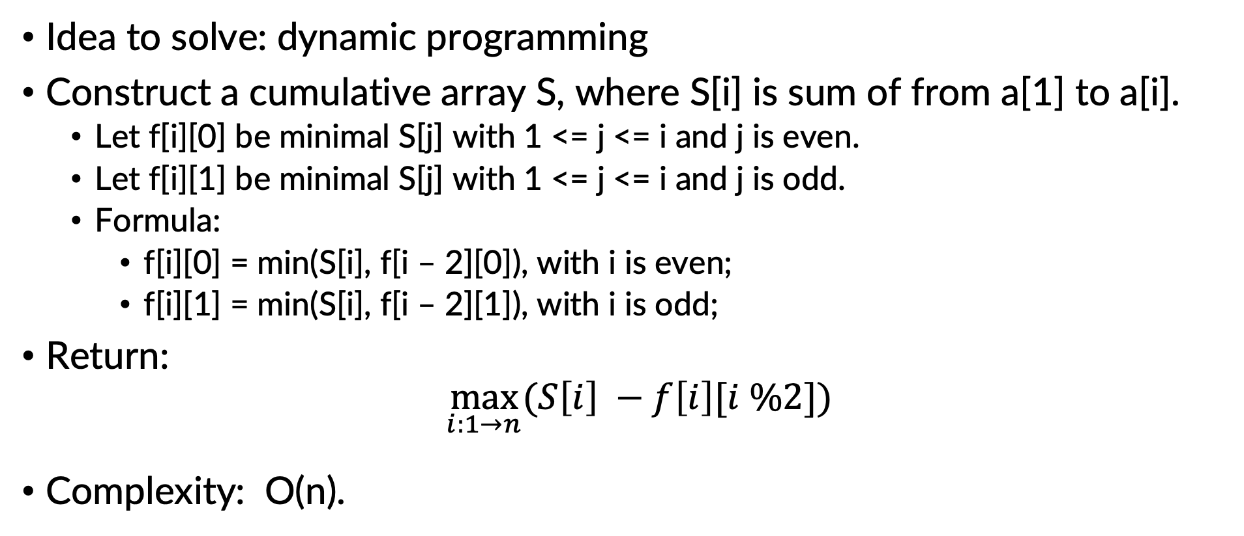
Max even sub-sequence
Idea to solve: dynamic programming
Construct a cumulative array S, where S[i] is sum of from a[1] to a[i].
Let f[i][0] be minimal S[j] with 1 <= j <= i and j is even.
Let f[i][1] be minimal S[j] with 1 <= j <= i and j is odd.
Formula:
f[i][0] = min(S[i], f[i – 2][0]), with i is even;
f[i][1] = min(S[i], f[i – 2][1]), with i is odd;
Return:
$\max_{i:1→n}{(S\left[i\right] −f\left[i\right][i \%2]})$
Complexity: O(n).

Slide 5
THANK YOU !

